Slide 1
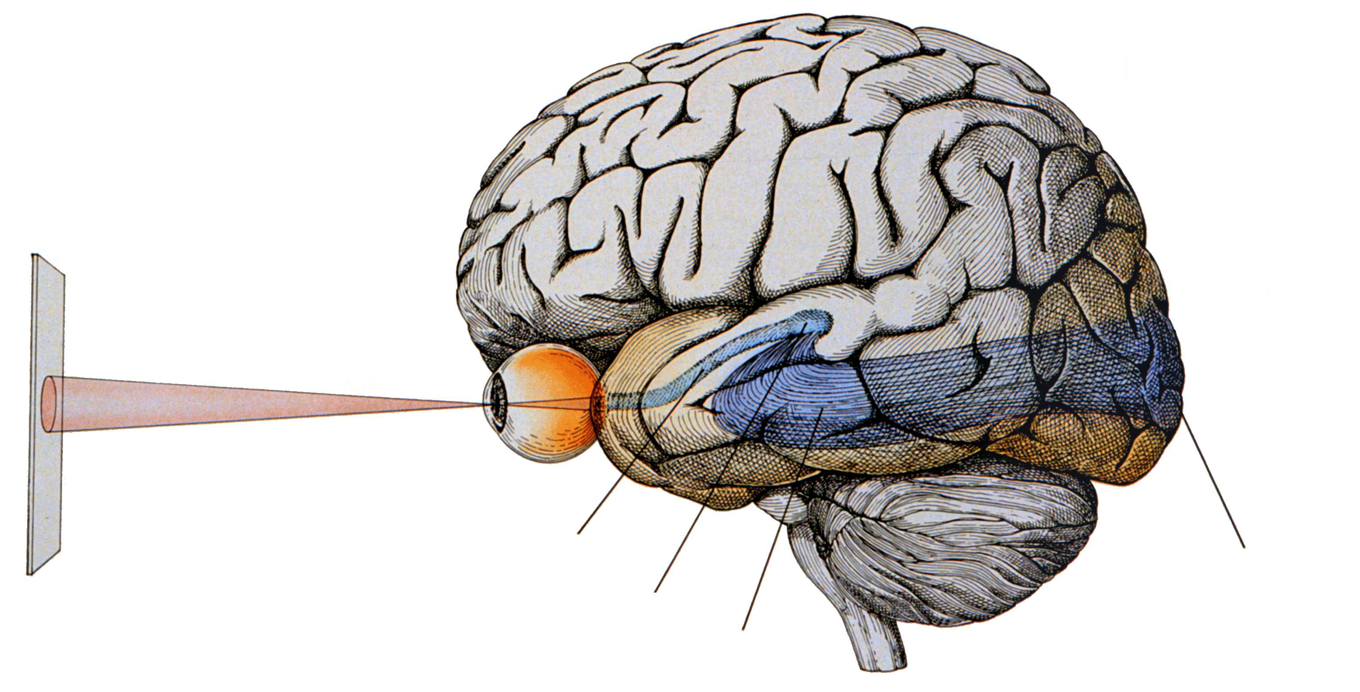
Introduction to sensory systems
15th October 2018
Thomas Mrsic-Flogel | t.mrsic-flogel@ucl.ac.uk

Slide 2
https://youtu.be/E76YBF3P0K0?t=54

Slide 3
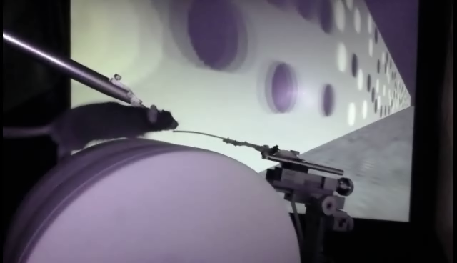
Mouse running in a virtual corridor

Slide 4
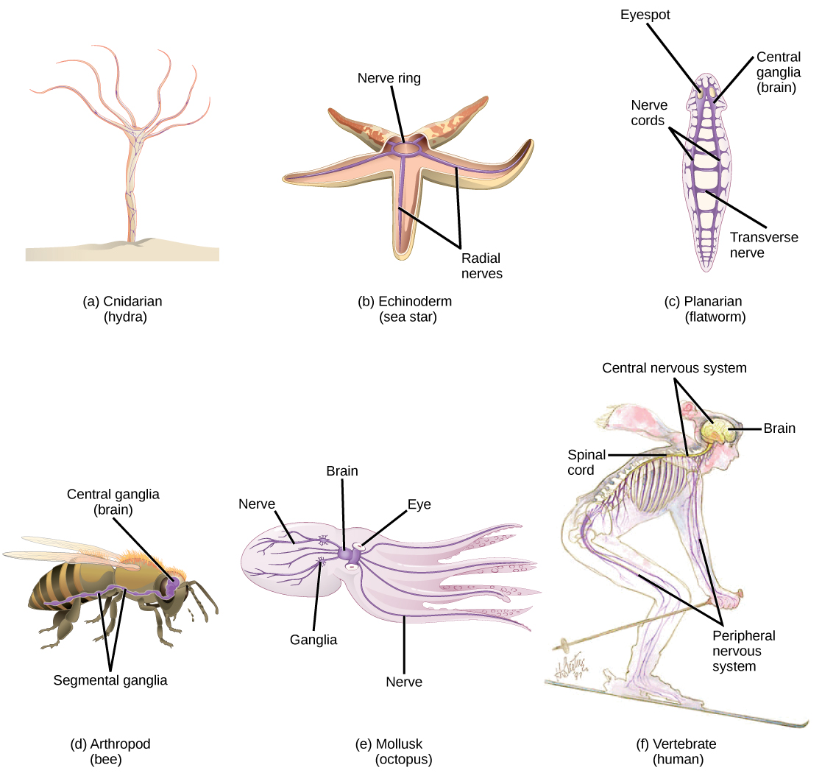
Why have sensory systems evolved?

Slide 5
What do sensory systems do?
Detect changes in the internal/external environment
Transduce any form of stimulus energy into action potentials
Filter & extract components of sensory input (receptive fields)
Adapt to different conditions, extending the dynamic range
Build complex representations
Build new representations (OD - depth, ITD/ILD – auditory space)
[Trigger actions]
[Store priors, infer and make predictions]
[Perception? (Maneesh Sahani)]

Slide 6
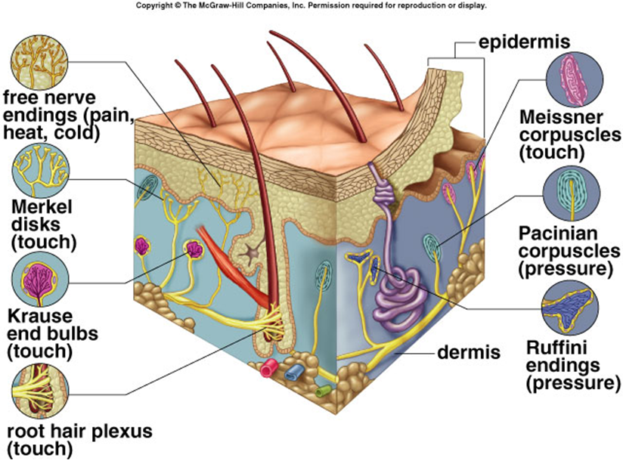
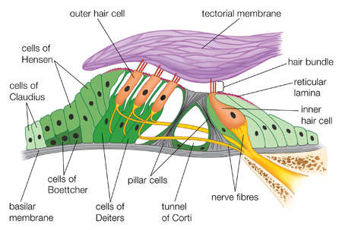
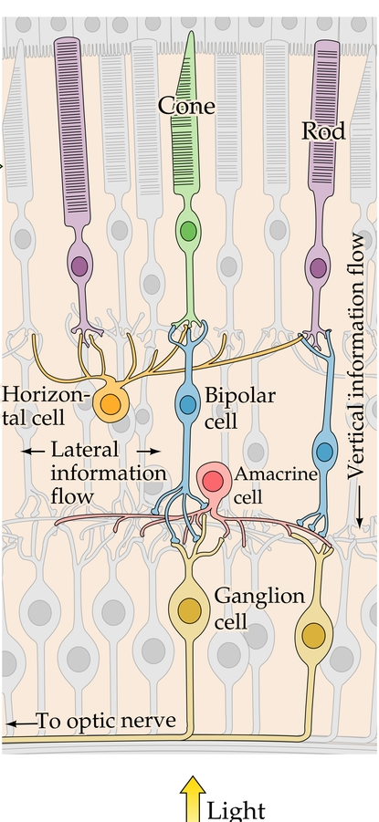
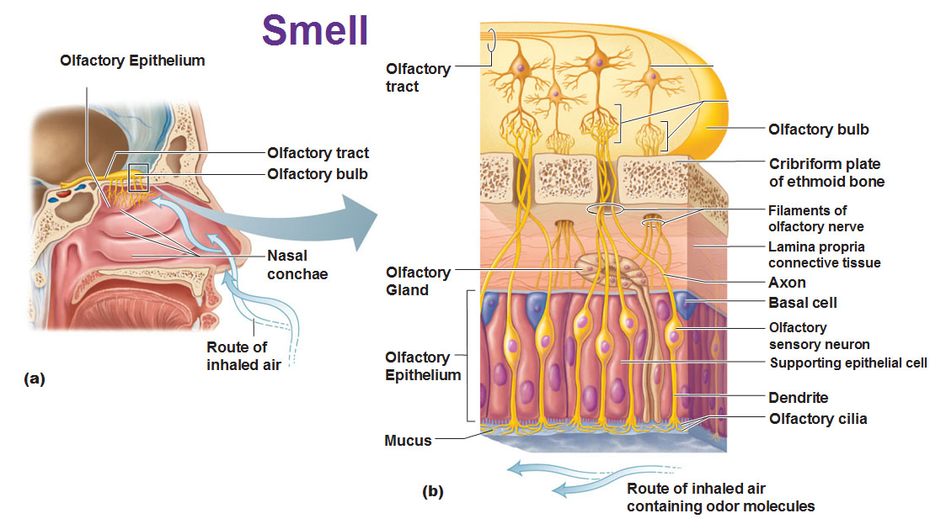
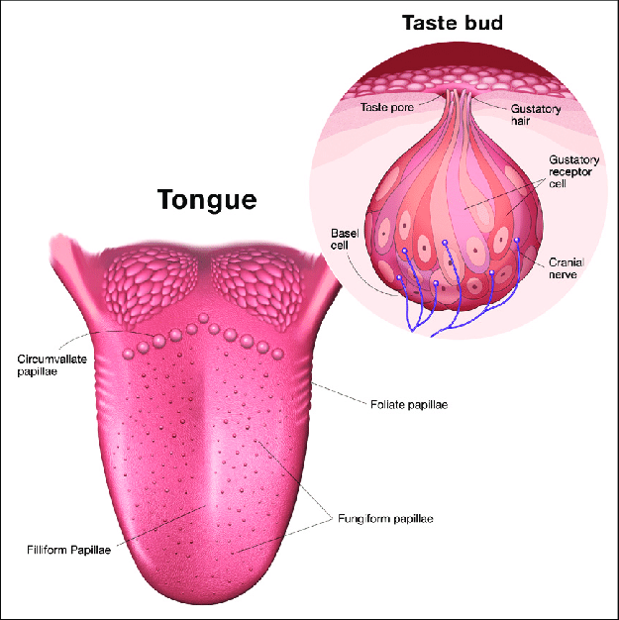
Transduction by specialised sensory receptors
Touch & Pain
Sound
Light
Smell
Taste

Slide 7
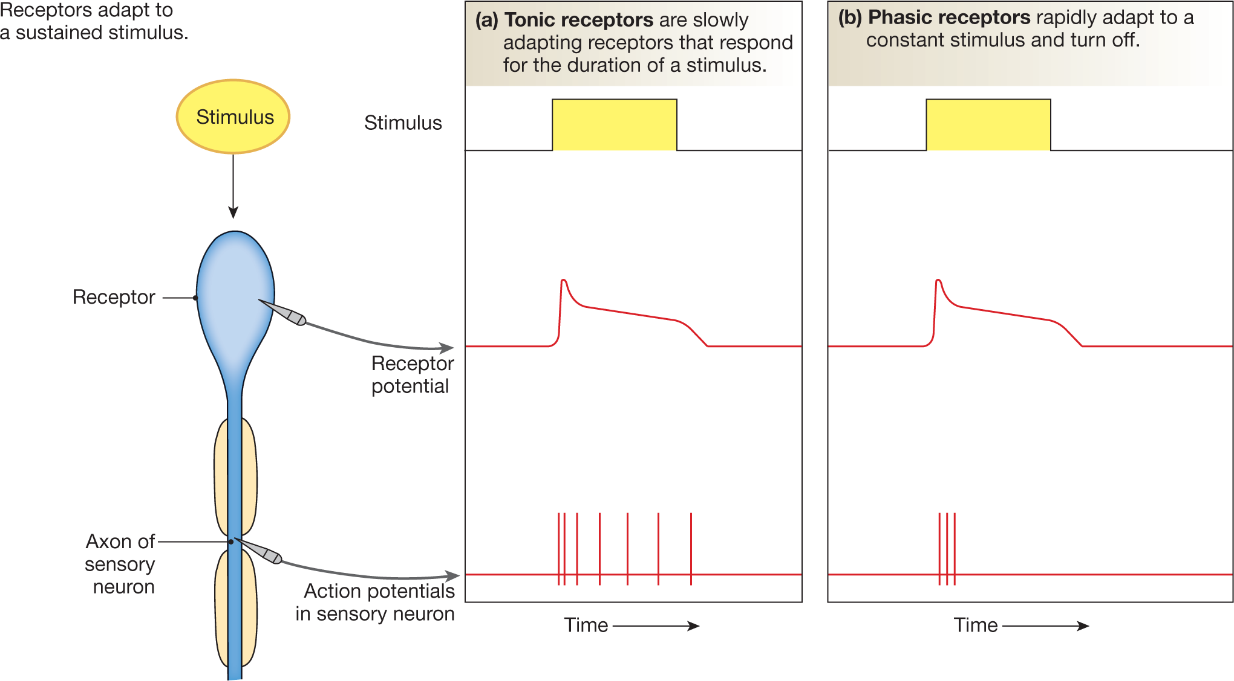
Adaptation
Sensory adaptation is a change over time in the responsiveness of the sensory system to a constant stimulus.
in sensory receptors and central neurons
enable detection of changes in sensory input, extending dynamic range of responses
rates determined by evolutionary adaptation to environmental statistics
negative feedback (intracellular & circuit based)

Slide 8
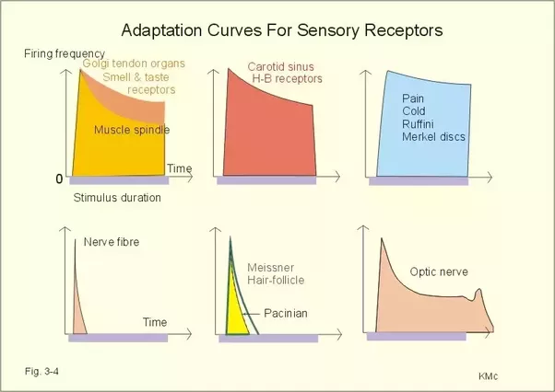
Adaptation: examples

Slide 9
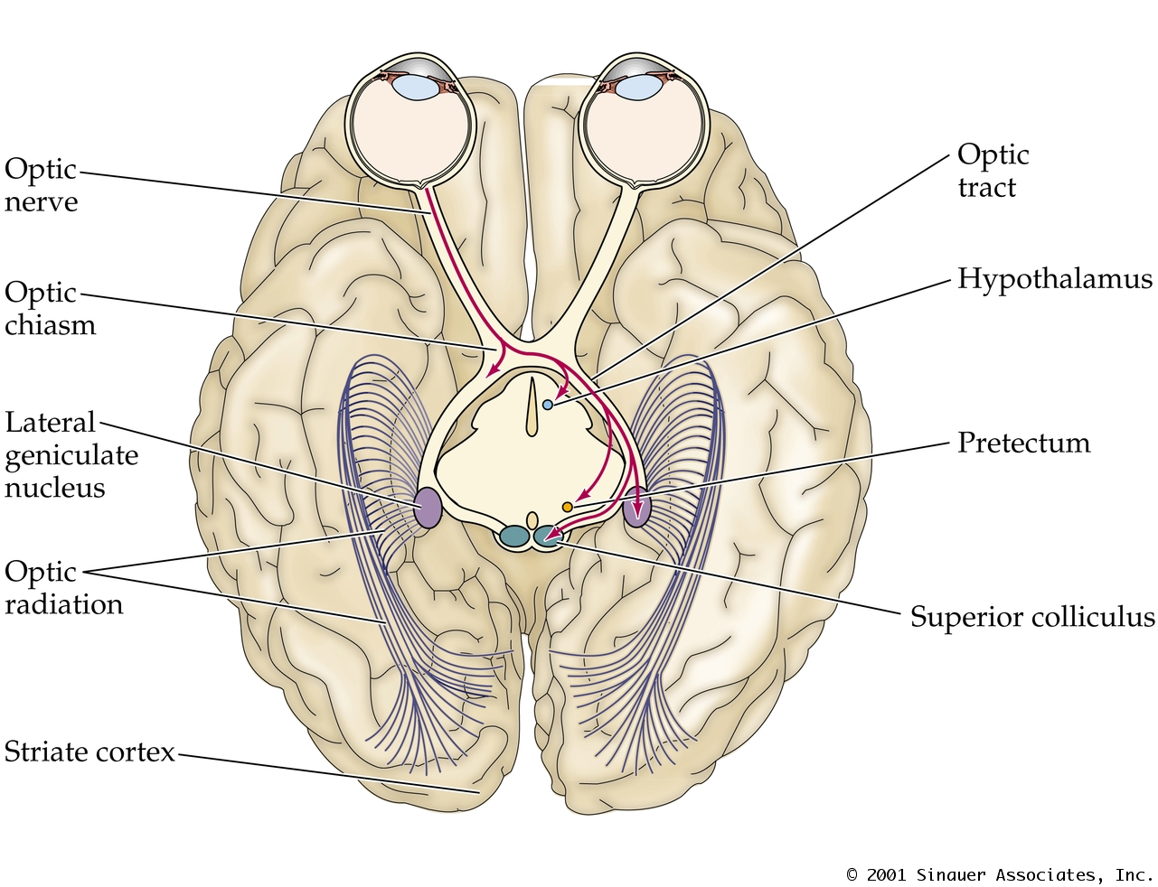
Extracting features from the sensory world
Mammalian visual system

Slide 10
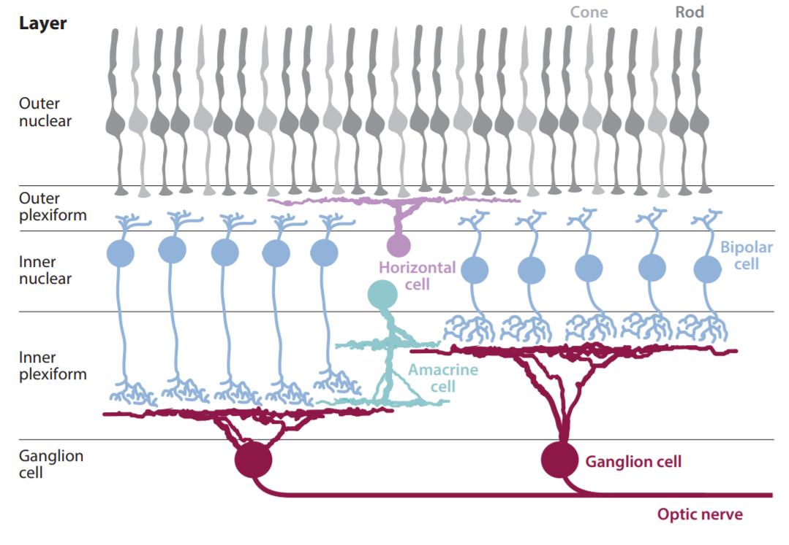
Structure of the retina

Slide 11
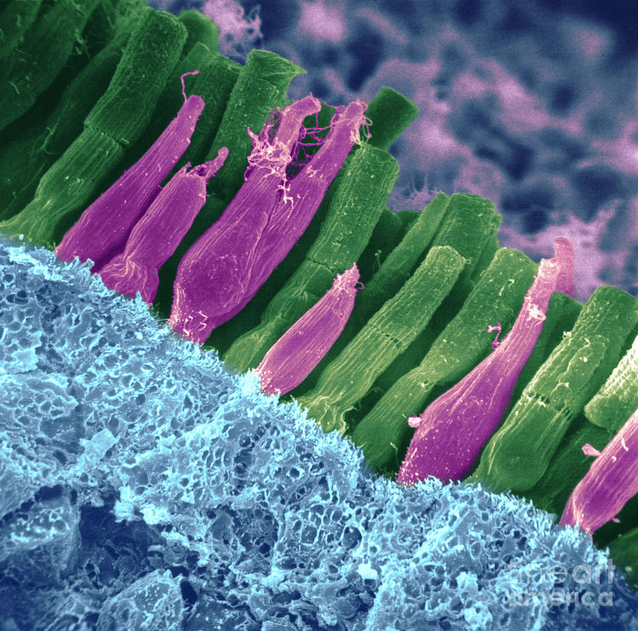
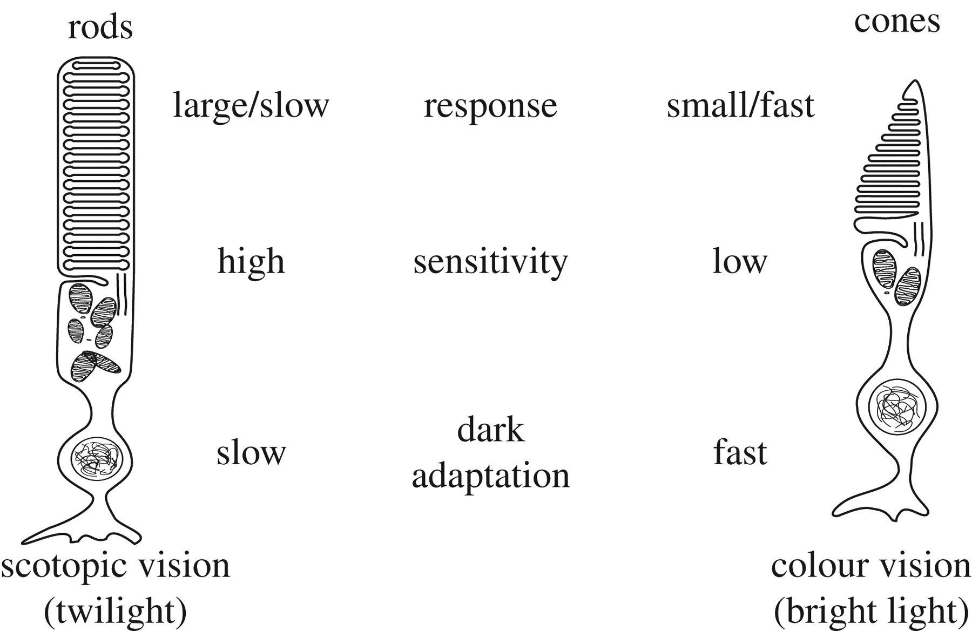
Photoreceptors: Rods and cones

Slide 12
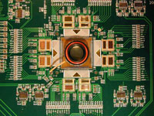
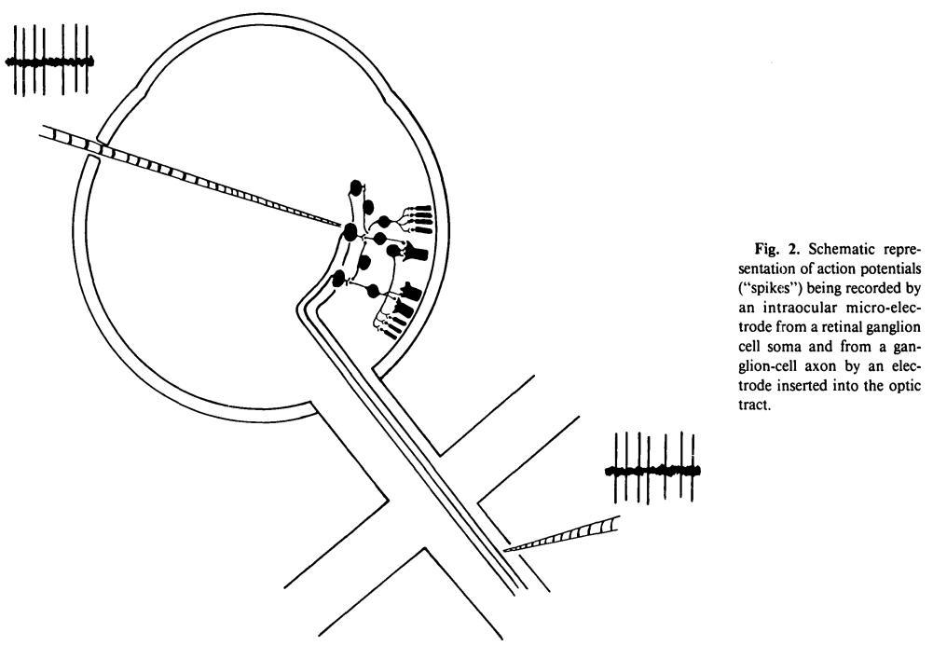
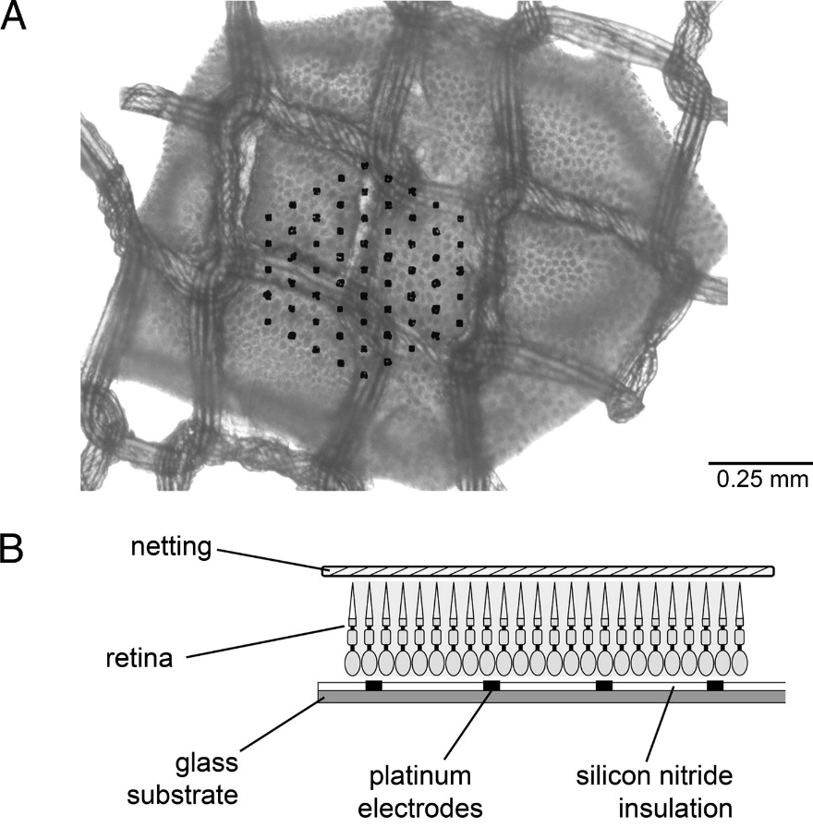
Recordings from the retina
In vivo electrode recordings
With electrode arrays
Notes:
Does anybody know what a receptive field is?

Slide 13
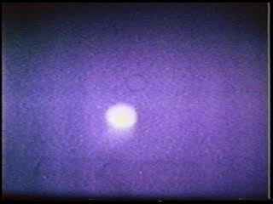
ON cell
Hubel and Wiesel
Recording in LGN

Slide 14
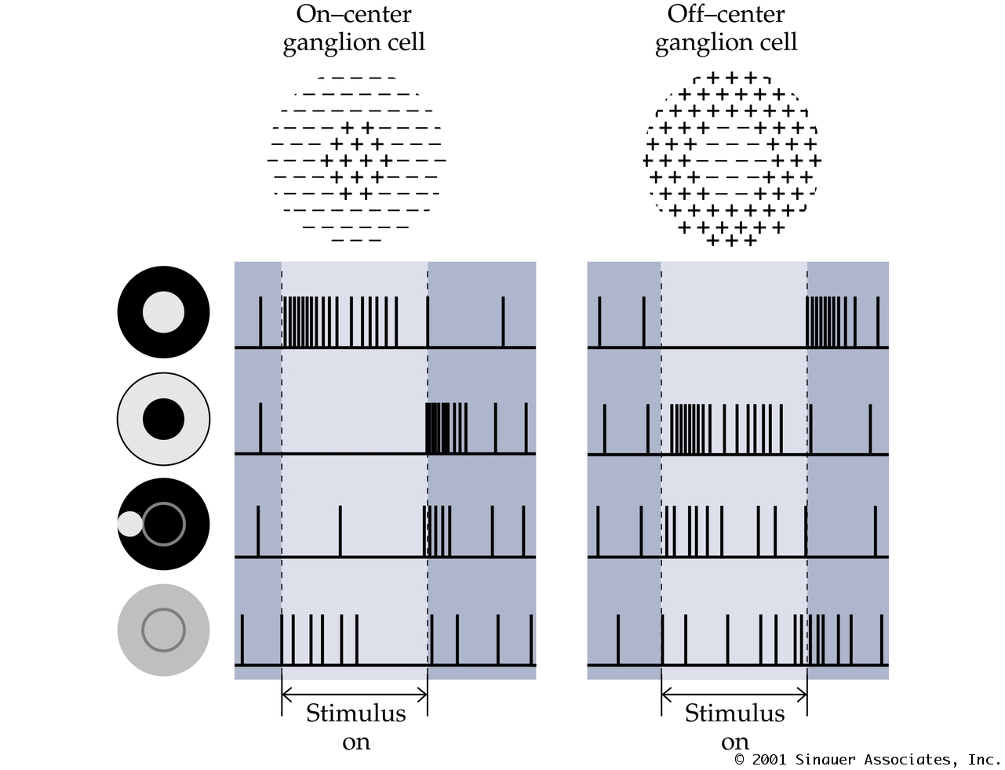
On-center
Off-surround
ganglion cell
Off-center
On-surround
ganglion cell
Notes:
Does anybody know what a receptive field is?

Slide 15
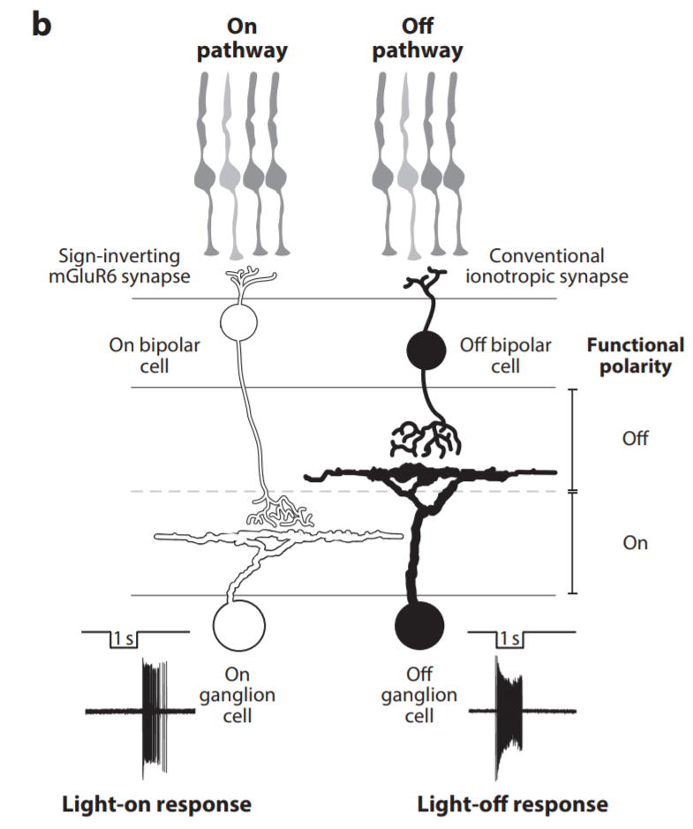
Circuits for generation of antagonistic subfields

Slide 16
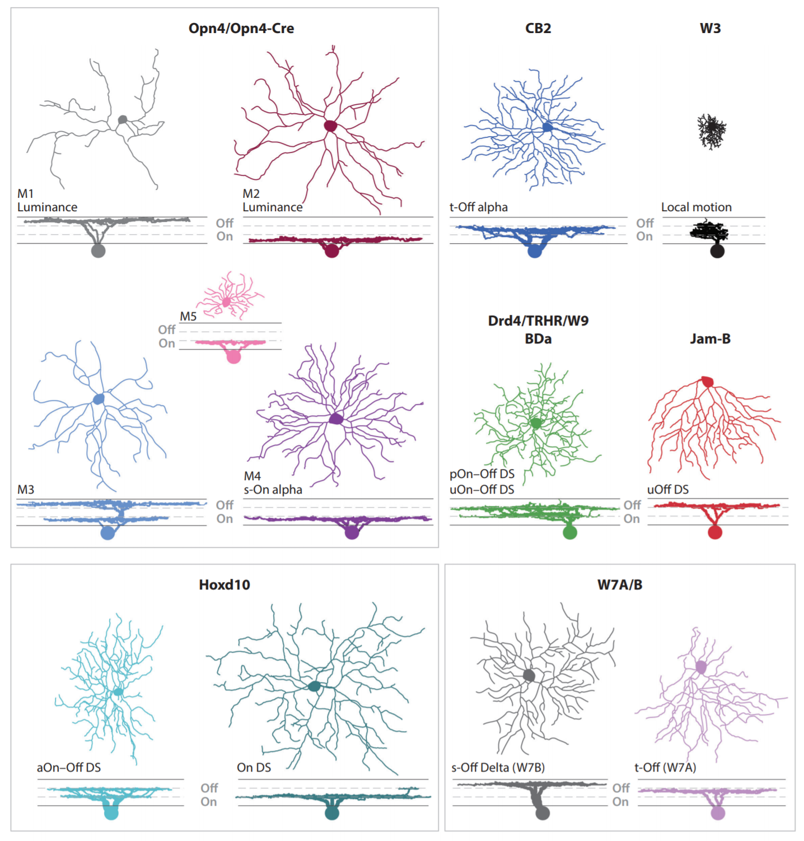
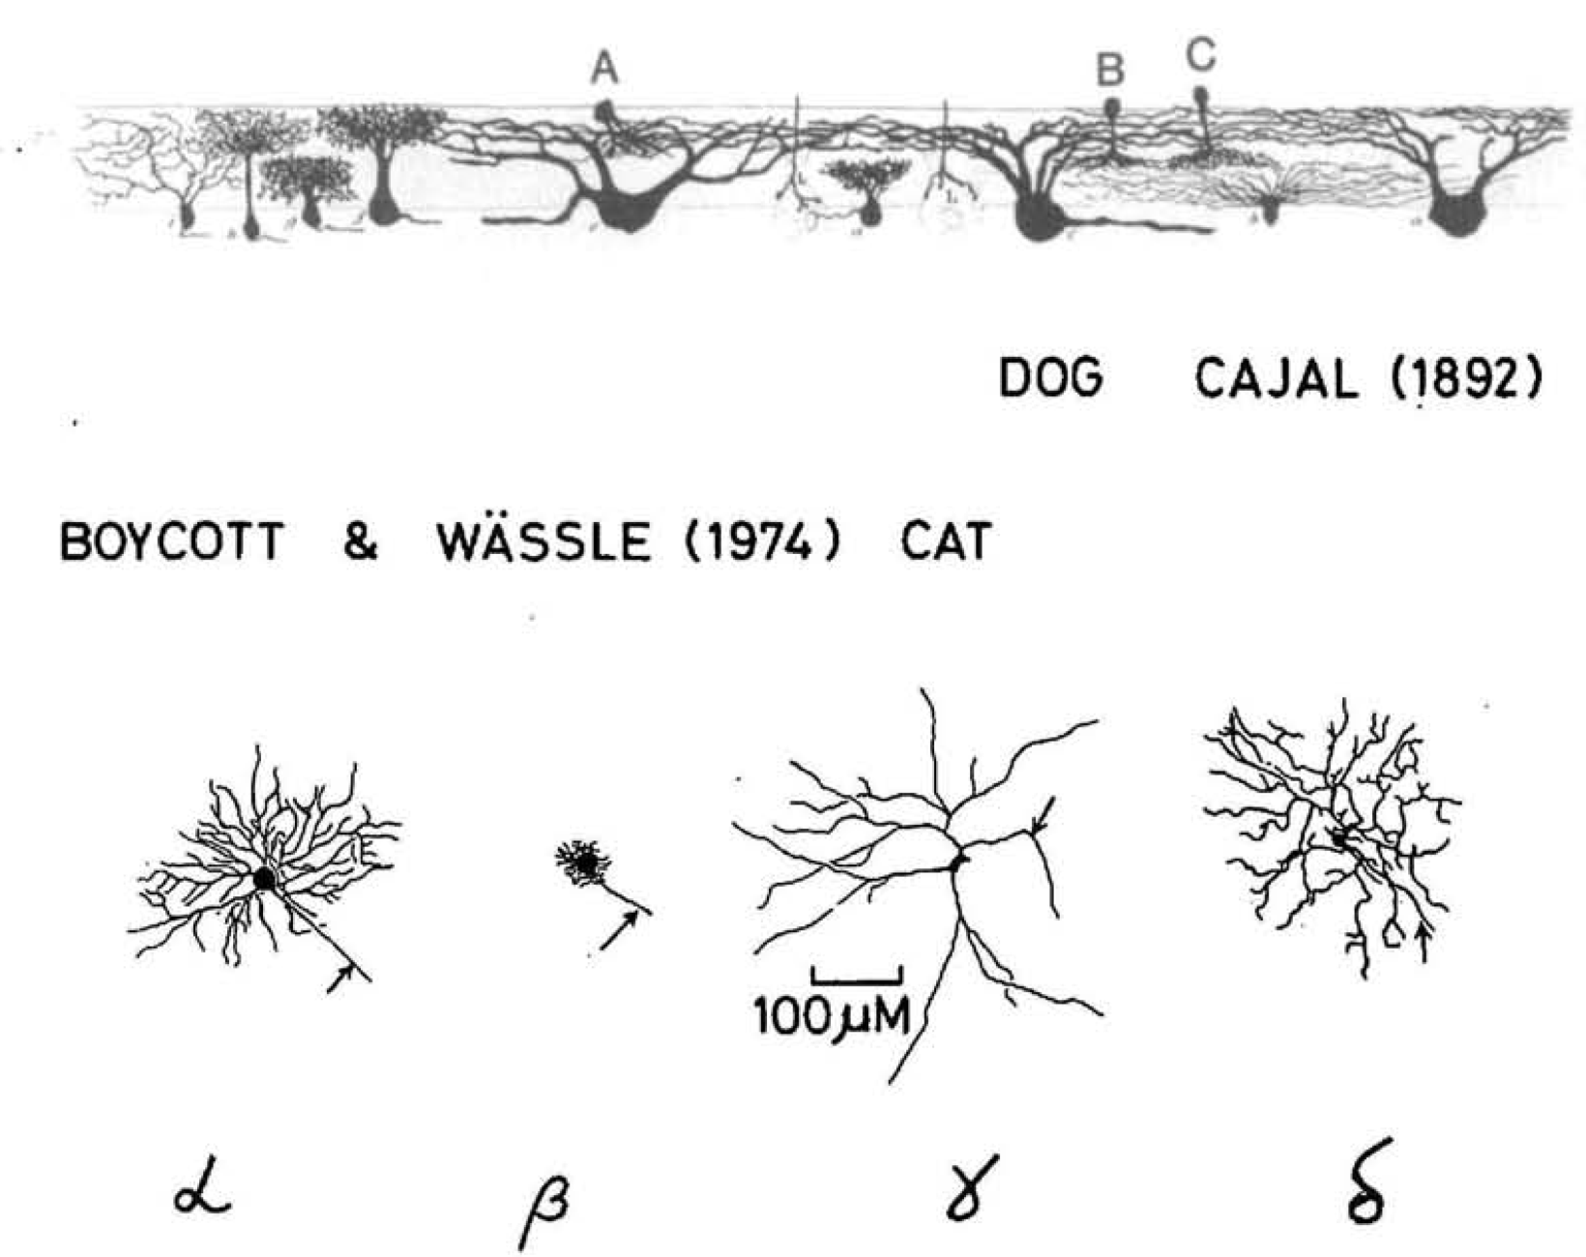
More than 25 types of retinal ganglion cells !!

Slide 17
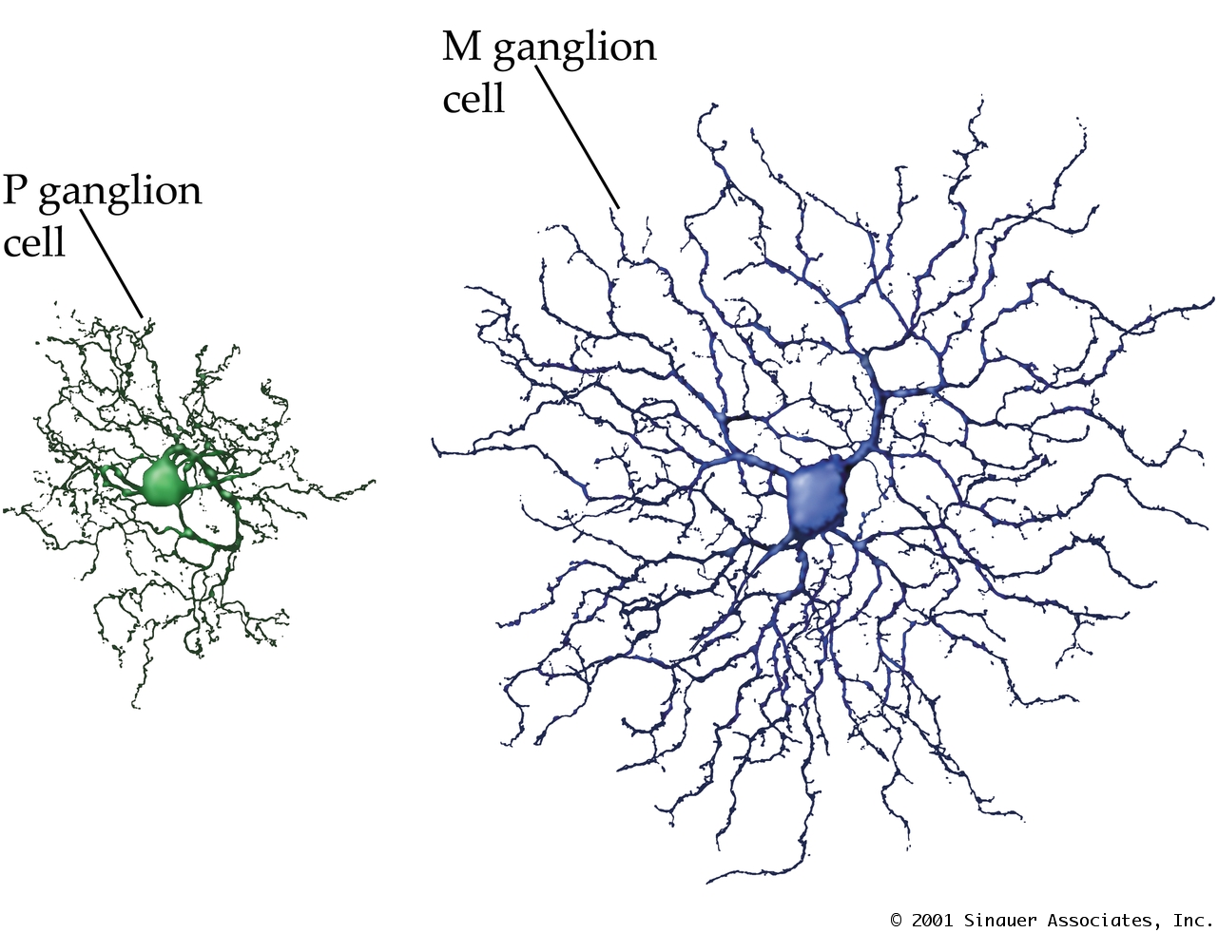
Magno- & Parvocellular Retinal Ganglion Cells
Magno cells:
e.g. parasol cell
Large dendrites
large RFs
transient responses
Color insensitive
Parvo cells:
e.g. midget cell
Small dendrites
small RFs
sustained responses
Color sensitive

Slide 18
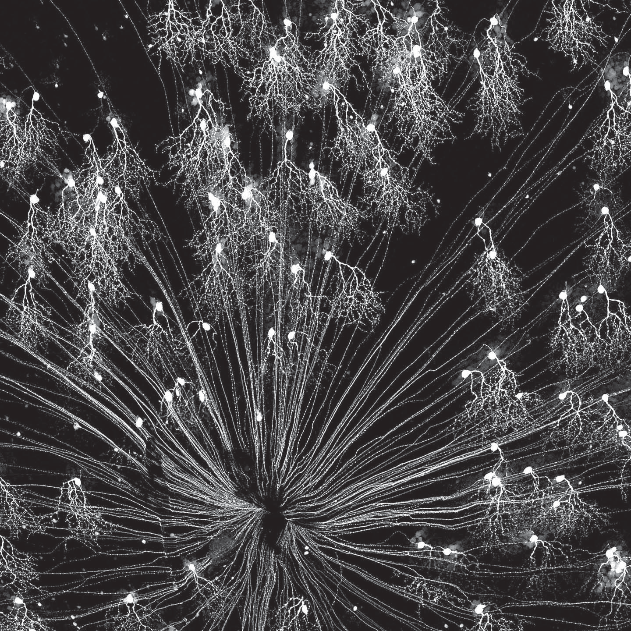
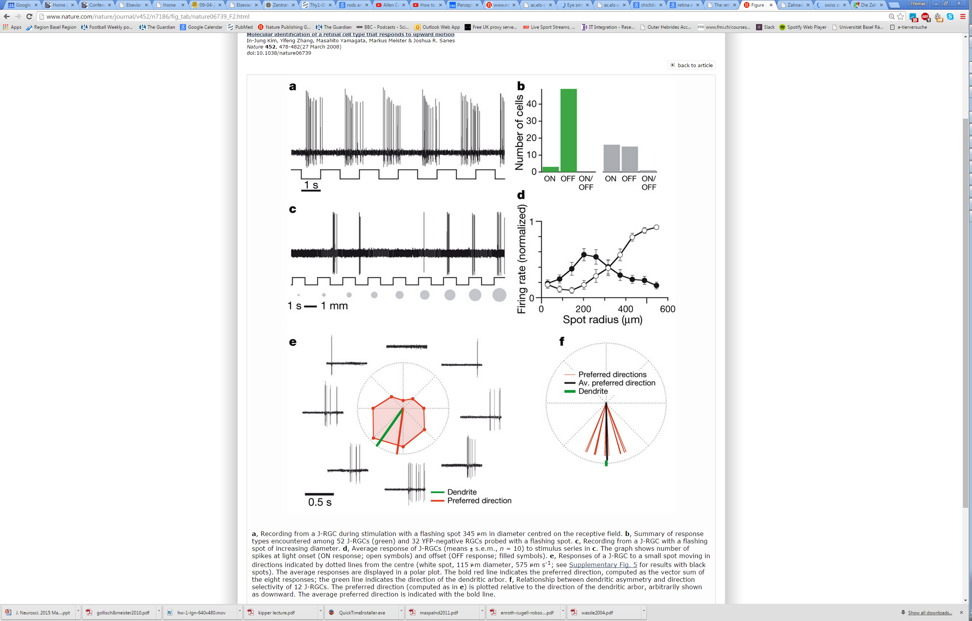
Another example: Jam-B cell
Ventrally oriented dendrites
Off-center
Upward motion selective
Kim et al 2008, Nature

Slide 19
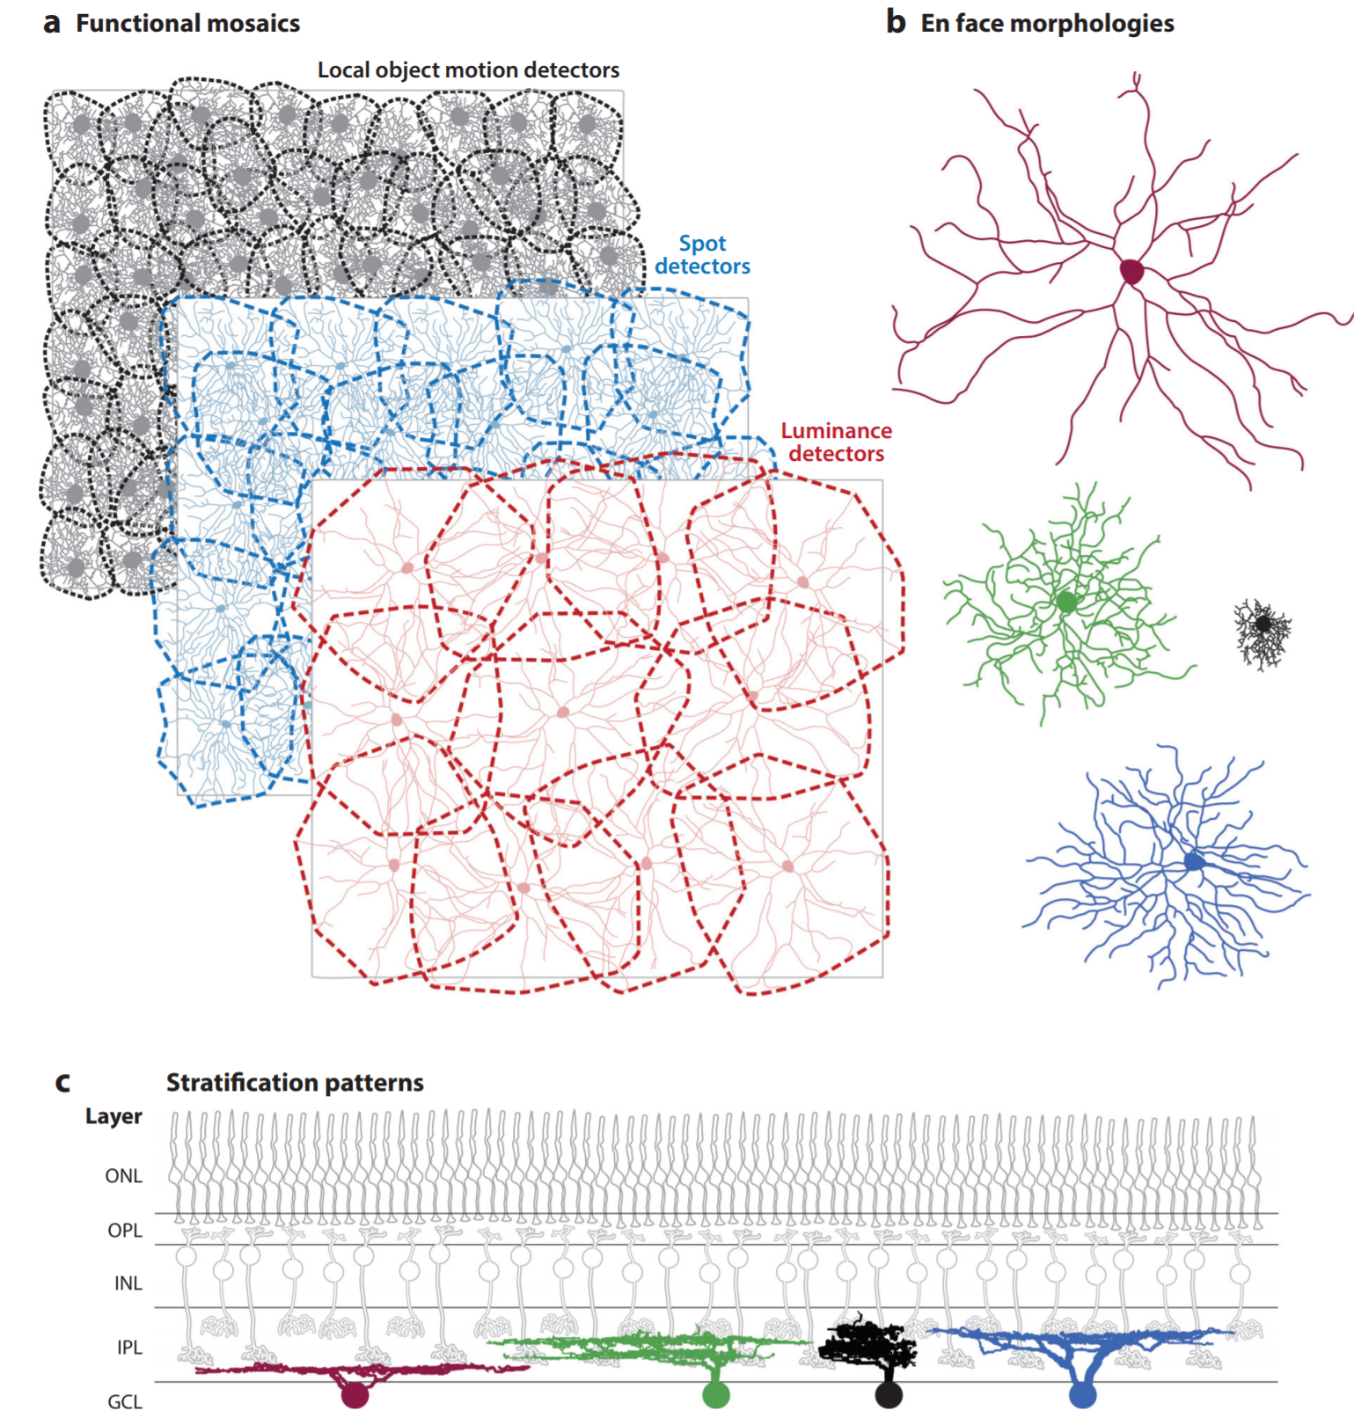
Tiling and mosaics
Each type of ganglion cells forms a mosaic in which individual ganglion cells tile the retina without leaving gaps

Slide 20
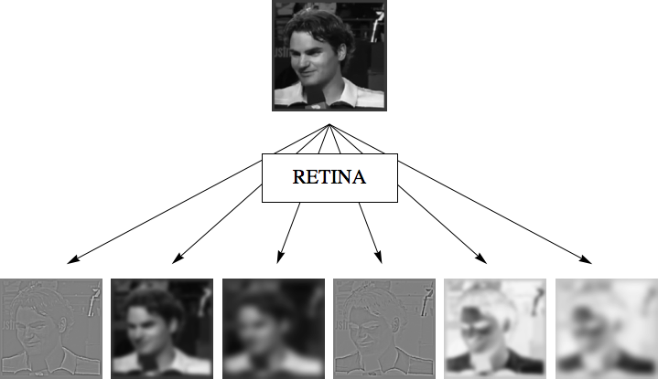
Retina sends ~25 parallel information channels to the brain
IN
OUT
Notes:
Why you need this: we would burn optic nerve…. We do not represent the entire image.. Getting rid of useless
information. Retina is part of a brain an outpost computing center

Slide 21
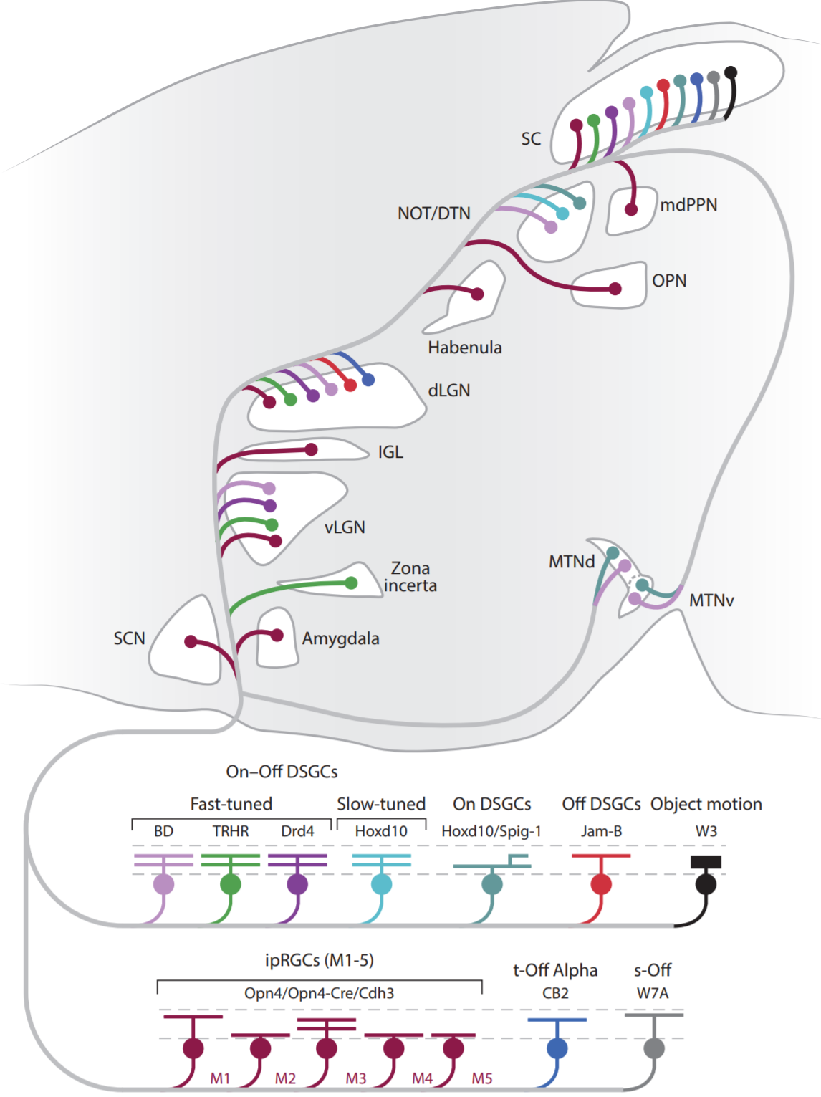
Retinal
output pathways

Slide 22
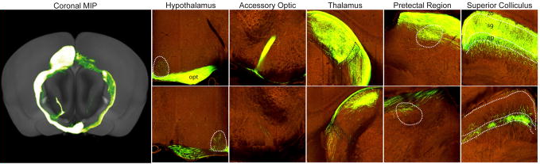
Main projection targets of mouse retinal ganglion cells

Slide 23
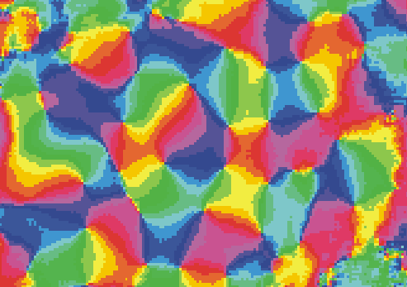
Building more complex representations in the neocortex
Orientation selectivity

Slide 24
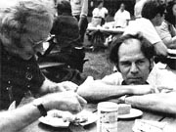
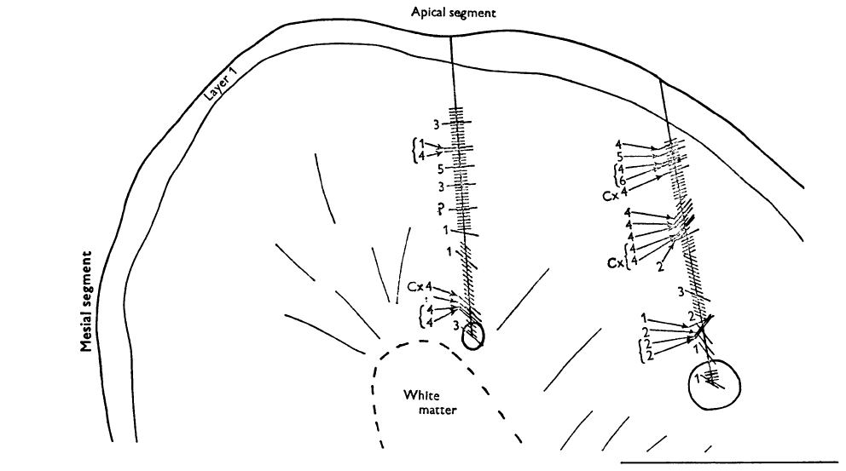
First recordings in cat primary visual cortex
Primary visual cortex (A17/ V1)
David Hubel & Torsten Wiesel, 1962

Slide 25
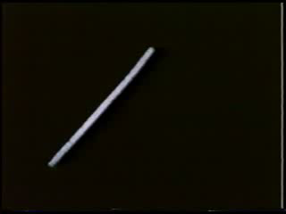
Simple cell in visual cortex
Hubel and Wiesel

Slide 26
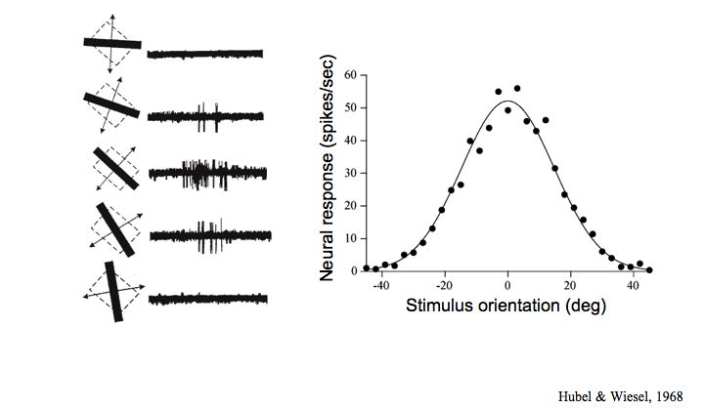
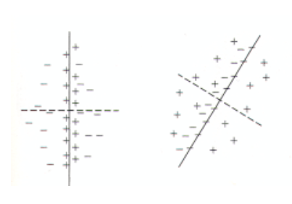
Orientation selectivity
Most cortical cells, in contrast to their retinal and geniculate counterparts, are sensitive to lines & edges of particular orientations.
Receptive fields are elongated rather than circular. Zones of “ON” or “OFF” regions are arranged so that the maximal response is obtained for a line of particular orientation.

Slide 27
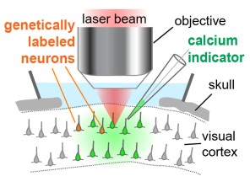
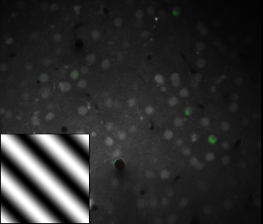
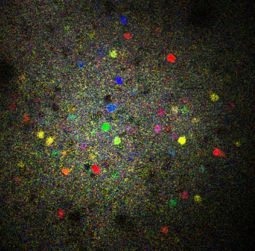
Mapping orientation preference in mouse visual cortex
∆F/F
0.3
Primary visual cortex
0.05
Pixel-wise map of orientation preference
0.2 ΔF/F
10s
90
90
90
50 μm
180
0
180
0
180
0
270
270
270

Slide 28
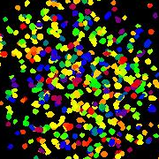
Mapping of orientation preference on the cortical surface
Mouse
Cat
50 µm
50 µm
Ohki et al., 2006
Notes:
Mapping of orientation preference in cat highly ordered with respect to orientation/OD preference, long range projections show functional specificiy, project significantly more to similarly tuned orientation domains.
Rat dramatically different, salt-and-pepper distribution: how does a cell maintain specificity when it is surrounded by and can have contacts with all these cells with dramatically different properties, how specific is the local connectivity, does it follow similar rules as long-rance connectivity in cat? Might consider this a mouse-specific problem, but of course cells in iso-orientation domain, have still very different receptive fields and show very different, uncorrelated responses to natural stimuli, similar problem: are there specific subnetworks for processing sensory informations? What is the hierarchy of connections (simple to complex cells), how is the response of a neuron reflected in its local inputs?

Slide 29
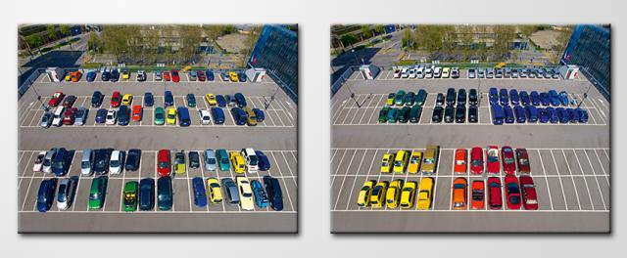
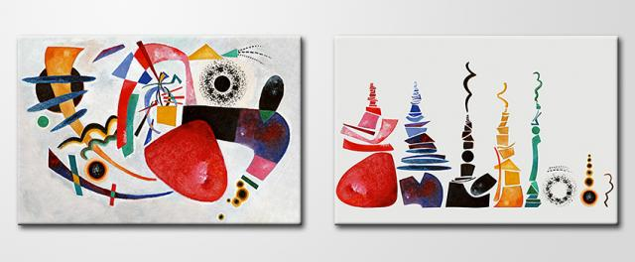
Kunst aufräumen (2002) by Ursus Wehrli

Slide 30
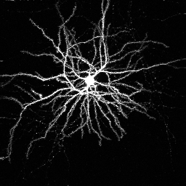
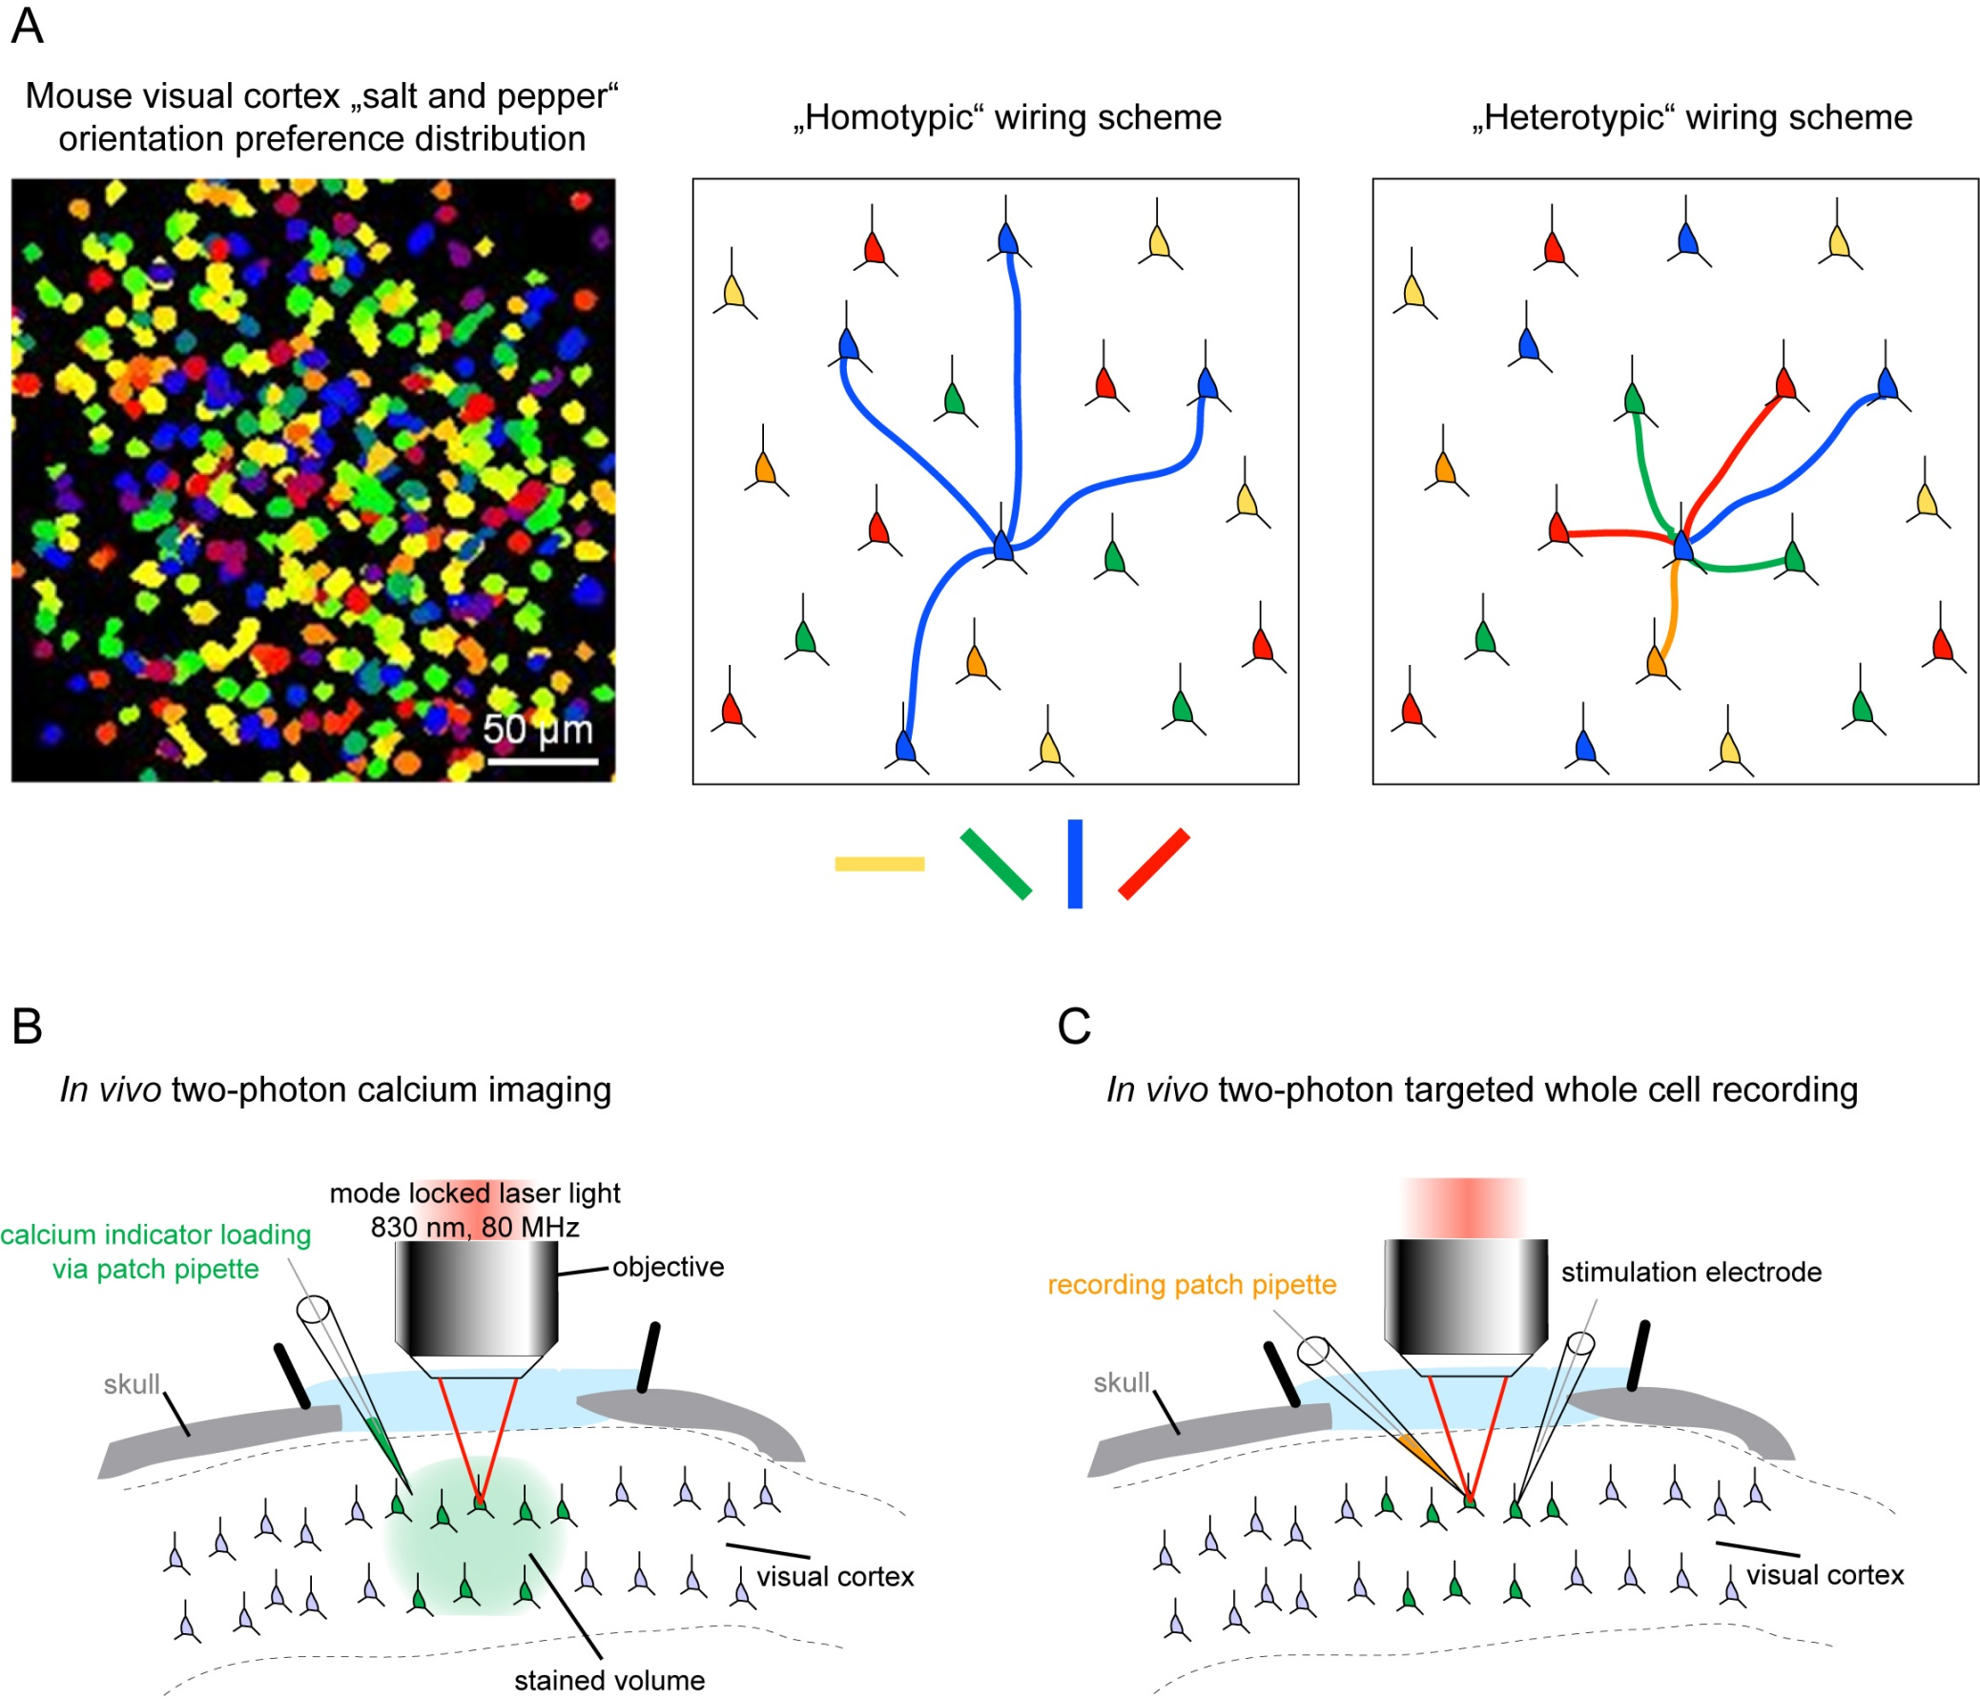
Functional organization of local synaptic connections in primary visual cortex
Mouse
Cat
50 µm
Layer 2/3 pyramidal cell
50 µm
Ohki et al., 2006
Selective
Unselective
or
Notes:
Mapping of orientation preference in cat highly ordered with respect to orientation/OD preference, long range projections show functional specificiy, project significantly more to similarly tuned orientation domains.
Rat dramatically different, salt-and-pepper distribution: how does a cell maintain specificity when it is surrounded by and can have contacts with all these cells with dramatically different properties, how specific is the local connectivity, does it follow similar rules as long-rance connectivity in cat? Might consider this a mouse-specific problem, but of course cells in iso-orientation domain, have still very different receptive fields and show very different, uncorrelated responses to natural stimuli, similar problem: are there specific subnetworks for processing sensory informations? What is the hierarchy of connections (simple to complex cells), how is the response of a neuron reflected in its local inputs?

Slide 31
Mapping of orientation onto cortical surface
Rodent V1
Cat/Monkey V1
Orientation map
Orientation map
Membrane
potential
Firing rate
0º 90º 180º
0º 90º 180º
Stimulus orientation
Stimulus orientation

Slide 32
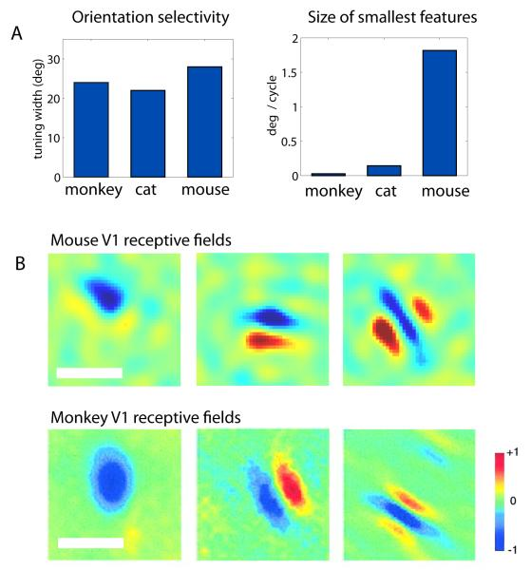
Orientation selectivity
20°
Conservation of receptive fields structure in visual cortex across species.
1.5°
From Niell & Huberman, 2011

Slide 33
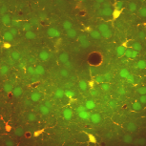


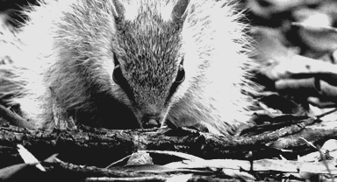


Receptive field mapping with 2p calcium imaging and reverse correlation
Example cell
Linear RF
20º
*
=
20%
dF/F
…
…
…
50 µm
Orientation
Spatial frequency
Receptive field size
Receptive field position
ON / OFF subdomain overlap

Slide 34





































































































Locally diverse receptive fields
Layer 2/3
180-208 um depth
50 µm

Slide 35
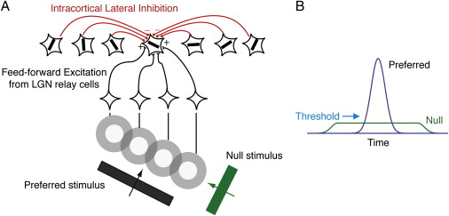
How does orientation selectivity arise in cortex?
Convergence & Integration of co-linear inputs from the thalamus

Slide 36

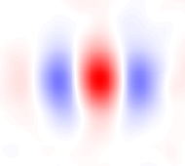
Subthreshold responses to drifting gratings
Drifting gratings
In vivo whole-cell recording (L2/3 pyramidal cell)
V1
-70 mV
Average membrane potential
Preferred
Orthogonal
10
mV
1 s
Modulation amplitude (F1)
Mean depolarisation (F0)
Notes:
How does the organisation of intracortical L2/3 connections contribute to these Vm dunamics and tuning of L2/3 cells. Ie. can we explain these dymaincs of mean depol and modulation in a given cell from the patterns of connections it recieves?

Slide 37
Subthreshold responses to drifting gratings
Drifting gratings
In vivo whole-cell recording (L2/3 pyramidal cell)
V1
-70 mV
Average membrane potential
Preferred
Orthogonal
10
mV
1 s
Example cell
Population average
25
25
20
20
15
15
Mean depolarization (F0)
Depolarization (mV)
Depolarization (mV)
10
10
Modulation amplitude (F1)
5
5
0
-90
-45
0
45
90
0
-90
-45
0
45
90
Δ Orientation
Δ Orientation
Notes:
How does the organisation of intracortical L2/3 connections contribute to these Vm dunamics and tuning of L2/3 cells. Ie. can we explain these dymaincs of mean depol and modulation in a given cell from the patterns of connections it recieves?

Slide 38
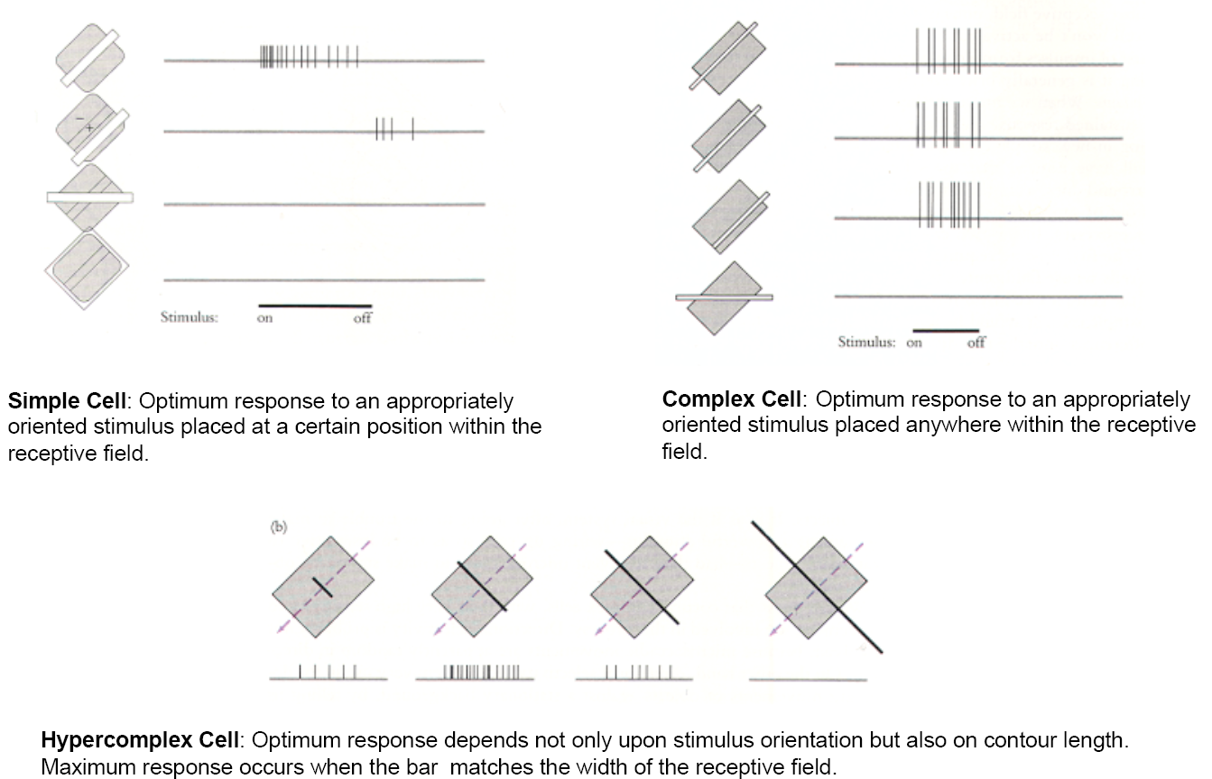
Simple, complex and hypercomplex cells

Slide 39
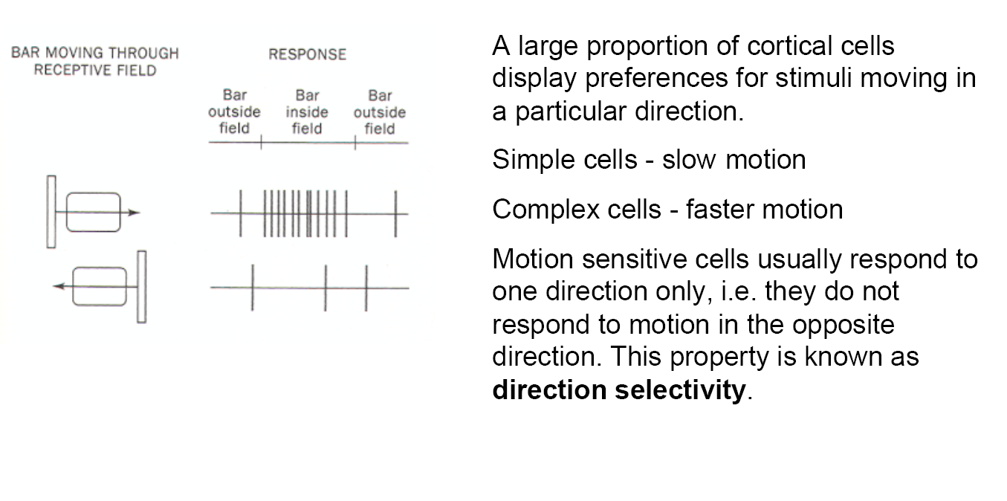
Directional selectivity

Slide 40

Complex cell in visual cortex
Hubel and Wiesel

Slide 41
Simple, complex and hypercomplex cells

Slide 42

Directional cell in visual cortex
Hubel and Wiesel

Slide 43
Building new representations: Binocularity

Slide 44

Integrating information from both eyes
Ocular dominance
&
Binocularity

Slide 45

Integrating information from both eyes
Ocular dominance
&
Binocularity
Parvocellular
Magnocellular

Slide 46

Integrating information from both eyes
Ocular dominance
&
Binocularity

Slide 47

Binocularity of cortical cells

Slide 48

Binocularity of cortical cells

Slide 49

Binocularity of cortical cells

Slide 50

Binocular disparity

Slide 51

Binocular disparity

Slide 52
Building new representations: Interaural integration for sound localisation

Slide 53


Computing sound location from interaural comparisons
Interaural time difference
(ITD)
Interaural level difference
(ILD)

Slide 54

Medial superior olive neurons are sensitive to ITDs of 10-20 microseconds

Slide 55

Medial superior olive neurons are sensitive to ITDs of 10-20 microseconds

Slide 56


Spatial receptive fields in the primary auditory cortex

Slide 57

Beyond primary visual cortex (secondary and higher order visual areas)
There are approximately 30 visual areas after V1.
Some areas seem specialized for processing a certain aspect of visual information. E.g., MT - motion, V4 - color (?).
Cortical areas dedicated to vision are densely interconnected, and can seem quite confusing at first glance.
However, a more general organization is evident in a pair of parallel pathways.
  What (P) pathway. Temporal lobe; recognition of objects.
  Where (M) pathway. Parietal lobe; motion, spatial orientation, localization.

Slide 58

Magno- and Parvocellular Pathways
Beyond area V1, information travels through other areas of the visual cortex: V2, V3, V4, M5 (a.k.a. V5), and on. We can think of the visual system as containing two primary pathways: the M-pathway, and the P-pathway.
P-pathway (WHERE = motion, flicker):
poor spatial resolution, good temporal resolution
m ganglion cells (RGC)
magnocellular layers (LGN)
an upper subdivision of layer 4 in V1 (not blobs)
V2 (thick stripes)
MT ('the motion area')
parietal lobes ('where')
P-pathway (WHAT = form/acuity, colour, texture):
poor temporal resolution, good spatial resolution
p ganglion cells (RGC)
parvocellular layers (LGN)
a lower subdivision of layer 4 in V1 (blobs and elsewhere)
V2 (thin stripes and interstripes)
V4 ('the color area')
inferotemporal lobes ('what‘)

Slide 59

Magno- and Parvocellular Pathways
Beyond area V1, information travels through other areas of the visual cortex: V2, V3, V4, M5 (a.k.a. V5), and on. We can think of the visual system as containing two primary pathways: the m-pathway, and the p-pathway.
m-pathway (WHERE = motion, flicker):
poor spatial resolution, good temporal resolution
m ganglion cells (RGC)
magnocellular layers (LGN)
an upper subdivision of layer 4 in V1 (not blobs)
V2 (thick stripes)
MT ('the motion area')
parietal lobes ('where')
p-pathway (WHAT = form/acuity, colour, texture):
poor temporal resolution, good spatial resolution
p ganglion cells (RGC)
parvocellular layers (LGN)
a lower subdivision of layer 4 in V1 (blobs and elsewhere)
V2 (thin stripes and interstripes)
V4 ('the color area')
inferotemporal lobes ('what‘)

Slide 60

Two ‘main’ processing streams (what and where pathways)
A more general organization is evident in a pair of parallel pathways.
What (P) pathway. Temporal lobe; recognition of objects.
E.g., IT cortex shape of objects, or area V4 - color of objects.
Where (M) pathway. Parietal lobe; motion, spatial orientation, localization.
E.g. Area MT specialised for motion processing.

Slide 61



Posterior parietal cortex
Dorsal part: more motor-related, body awareness (asomatognosia, optic ataxia)
Ventral part: spatial perception (hemispatial neglect, constructional apraxia, cannot perceive the spatial relations of parts of an object)
Hemispatial neglect
constructional apraxia
Notes:
asomatognosia: lack of awareness of the condition of all or part of one's body
The lateral intraparietal (LIP) contains a map of neurons (retinotopically-coded when the eyes are fixed^{[8]}) representing the saliency of spatial locations, and attention to these spatial locations. It can be used by the oculomotor system for targeting eye movements, when appropriate.^{[9]}
The ventral intraparietal (VIP) area receives input from a number of senses (visual, somatosensory, auditory, and vestibular^{[10]}). Neurons with tactile receptive fields represent space in a head-centered reference frame.^{[10]} The cells with visual receptive fields also fire with head-centered reference frames^{[11]} but possibly also with eye-centered coordinates^{[10]}
The medial intraparietal (MIP) area neurons encode the location of a reach target in nose-centered coordinates.^{[12]}
The anterior intraparietal (AIP) area contains neurons responsive to shape, size, and orientation of objects to be grasped^{[13]} as well as for manipulation of hands themselves, both to viewed^{[13]} and remembered stimuli.^{[14]} The AIP has neurons that are responsible for grasping and manipulating objects through motor and visual inputs. The AIP and ventral premotor working together, are responsible for visuomotor transformations for actions of the hand.^{[7]}

Slide 62


WHERE pathway: Awareness of space (right parietal lobe)
Hemineglect (unilateral neglect) is a disabling condition following brain damage in which patients fail to be aware of items to one side of space. Neglect is most prominent and long-lasting after damage to the right inferior parietal lobe (IPL), particularly following a stroke. Such individuals with right-sided brain damage often fail to be aware of objects to their left, demonstrating neglect of leftward items.
Notes:
Up to here 150 min (w some slides left out)

Slide 63


WHAT pathway: Face selective cells in inferotemporal (IT) cortex
In humans, brain damage to IT cortex can lead to prosopagnosia - also called face blindness - an impairment in the recognition of faces.
Notes:
Up to here 150 min (w some slides left out)

Slide 64



Slide 65

WHAT pathway: Face profile cells in inferotemporal (IT) cortex
Notes:
Up to here 150 min (w some slides left out)

Slide 66

WHAT pathway: Object orientation selective cells in IT cortex
Notes:
Up to here 150 min (w some slides left out)

Slide 67

Activations by object images and partial features in IT cortex
Clusters of cells having overlapping and slightly differing selectivities may work together to confer object recognition abilities that are invariant to viewing conditions
Tsunoda et al. 2001
Notes:
Activations by object images and partial features. The outline of the activation spots was determined at one-half of the maximal signal in an individual spot. Only the spots including pixels with significant activation during the stimulation compared with the blank period are shown. (A) The head activated a partial set of the spots activated by the cat and the silhouette of the head activated a partial set of the spots activated by the complete head. (B) The color and gray image and silhouette of a fire extinguisher activated three spots. The body of the fire extinguisher activated a new spot, as well as two of the three spots activated by the fire extinguisher. Single-cell recordings conducted after the optical imaging showed that Spot 1 was activated by protrusions, Spot 2 by a curved line and Spots 3 and 4 by a rectangular shape. Cells in Spot 3 were inhibited by a curved line, but those in Spot 4 were not. Cited from Tsunoda et al. (Tsunoda et al., 2001).

Slide 68

Feedforward hierarchy for object representation
Tomaso Poggio , MIT

Slide 69
Specialised cell types, circuits and pathways
Elemental computations: selection, convergence, amplification, contrast enhancement
Generate representations useful for detection, action, perception or for combining with other modalities
Refined by evolution to the suit the ethology of each species

Slide 70




Ventral and dorsal streams in visual processing
Damage to ventral stream areas:
Visually-guided action (‘WHERE’)
Object recognition (‘WHAT’)
Notes:
Not as strictly segregated as textbook view! Interactions, response properties not completely segregated…

Slide 71

Association cortex
Temporal cortex: recognition of sensory stimuli, storage of semantic knowledge
Parietal cortex: sensory guidance of motor behavior, spatial perception, motion, relative position of objects, self
Ventral/dorsal stream
Frontal cortex: organizing behaviour, planning, working memory
Notes:
Association cortex: anything that is not mostly sensory or mostly motor

Slide 72
Organisational principles
Maps & topography
Parallel pathways

Slide 73


Subcortical visual pathways
(reflexive responses, arousal, fear)
Cortical visual pathways
(complex representations, associations, perception)

Slide 74



Topographic maps
Why have sensory systems evolved?
Retinotopic
organisation
Tonotopic organisation

Slide 75

Why have sensory systems evolved?

Slide 76


Alignment of auditory, visual and tactile maps of space in superior colliculus

Slide 77

Alignment of auditory, visual and tactile maps of space in superior colliculus

Slide 78
Reading
Book chapters:
Eye, Brain and Vision – Hubel, Chapters 4-6.
Fundamental Neuroscience (Zigmond et al) – Chapter on Vision
Neuroscience (Bear et al) – Vision chapters
References:
Gollisch & Meister (2010) Eye Smarter than Scientists Believed: Neural Computations in Circuits of the Retina. Neuron 2010.
Hubel, D.H. & Wiesel, T.N. (1977) Functional architecture of the macaque monkey visual cortex. Proc. Roy. Soc. (Lond.) 198, 1-59.
Livingstone, M.S. & Hubel, D.H. (1988) Segregation of form, color, movement and depth: Anatomy, physiology and perception. Science 240, 740-749.
Ohki K, Reid RC. Specificity and randomness in the visual cortex. Curr Opin Neurobiol. 2007 Aug;17(4):401-7. Epub 2007 Aug 27. Review.
Sincich LC, Horton JC. The circuitry of V1 and V2: integration of color, form, and motion. Annu Rev Neurosci. 2005; 28:303-26. Review.
Callaway EM. Structure and function of parallel pathways in the primate early visual system. J Physiol. 2005 Jul 1;566(Pt 1):13-9. Epub 2005 May 19. Review.
Logothetis NK. Single units and conscious vision. Philos Trans R Soc Lond B Biol Sci. 1998 Nov 29;353(1377):1801-18. Review.

Slide 79

Distribution of rods and cones

Slide 80


Circuits for generation of antagonistic subfields

Slide 81
More than 25 types of retinal ganglion cells !!

Slide 82


Slide 83


Adaptation

